Slide 1

IDSS· AIE424 · SPRING 2025–2026
An Integrated AI-Driven Framework for
Clinical Diagnostics & Pharmaceutical Decision Support
Team Members:
1- Mohamed Rady 222200004 2- Mohamed Elsayed Nagy 222200002
3- Omar Saeed 222101064 4- Aser Mohamed Ali 222102487 5- Mostafa Mahmoud 222101612
Under Supervision: Dr/ Safa El Askary

Slide 2

INTRODUCTION
MedAI Insight is an end-to-end clinical intelligence dashboard unifying AI computer vision, NLP, and pharmaceutical decision support into a single platform — designed for the Egyptian healthcare context.
Module I
Module II
Module III
YOLOv12 Radiology Engine
Lab Interpreter
MedAdvisor Egypt DSS
Real-time chest X-ray pathology detection across 5 classes with 94.1% precision.
OCR + Groq NLP transforms CBC/metabolic panels into dual-mode clinical narratives.
3-tier Neo4j + SCRE pharmaceutical substitute engine — 19,000+ EDA records.
94.1%
80.1%
70.3%
0.81
<1s
Precision
mAP@50
Recall
F1-Score
Inference
EXCEEDS SotA
EXCEEDS SotA
Near Target
EXCEEDS SotA
Real-time

Slide 3
Problem Statement & Motivation
CURRENT CHALLENGES
HOW MedAI ADDRESSES THEM
Fragmented Diagnostics
Unified Dashboard
X-rays, lab reports & prescriptions managed across disconnected tools — no unified view.
Consolidates radiology, lab, and pharma modules into one intelligent interface.
High Patient-Doctor Ratio
Egypt-Localized AI
Egypt's healthcare load creates diagnostic bottlenecks, delaying life-saving treatments.
EDA-compliant Neo4j knowledge graph ensures market-relevant, legally approved outputs.
Drug Unavailability
Decision Support
Import restrictions cause frequent brand-name shortages at the point of dispensing.
Frees clinicians from low-level tasks — enabling focus on high-level patient care.
Manual Lab Interpretation
Real-Time Speed
Lab result analysis remains manual, slow, and prone to clinical miscommunication.
Sub-second inference enables deployment without disrupting clinical workflow.

Slide 4
Project Objectives
Five Core Goals
01
Pathology Detection
02
Clinical Translation
03
Market Localization
YOLOv12s model detecting pulmonary anomalies in chest X-rays with ≥90% precision threshold.
Automate lab document interpretation into dual-mode summaries for clinicians and patients.
Solve Egyptian medication shortages via EDA-compliant bioequivalent substitute recommender.
04
High-Speed Inference
05
Unified Interface
Achieve sub-second processing for computer vision tasks — enabling real-time clinical use.
Consolidate disparate clinical tools into a single Streamlit dashboard, reducing cognitive load.

Slide 5
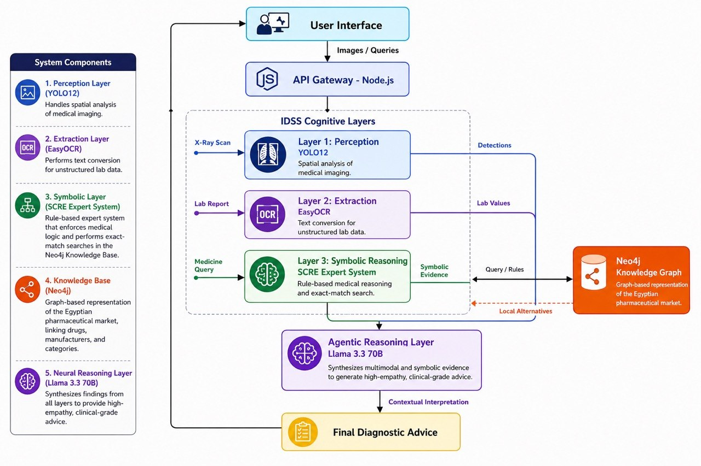
System Architecture
Integrated IDSS — End-to-End Data Flow
TECHNOLOGY STACK
Vision Engine:
YOLOv12s (Ultralytics 8.2)
LLM Reasoning:
Groq LPU™ — Llama 3.3 70B
Pharma DSS:
Neo4j AuraDB + SCRE Engine
Frontend:
React.js + Framer Motion
Backend:
Express.js (Node.js)
Security:
TLS 1.3 — Zero Retention

Slide 6
AI Pipeline — The Perception–Extraction–Reasoning Loop
1
2
3
4
5
6
7
Patient
Input
▶
Input
Router
▶
Pre-
processing
▶
Inference
Engine
▶
Post-
processing
▶
Report
Generation
▶
Dashboard
Display
Upload via UI
Image vs Doc
Resize / OCR
YOLO or Groq
NMS / Entities
Clinical Narrative
Risk Badges
COGNITIVE LOOP — HOW THE AI REASONS
PERCEPTION
EXTRACTION
REASONING
Visual Layer
→
Contextual Layer
→
Cognitive Layer
YOLOv12 backbone processes raw X-ray pixels, generating multi-scale feature maps identifying pathological patterns across 5 classes.
OCR and NLP translate visual characters into clinical entities — Blood Glucose, Hemoglobin — providing structured facts for reasoning.
Groq Llama 3.3 70B synthesizes visual patterns and textual facts into a structured, actionable clinical report for the clinician.

Slide 7
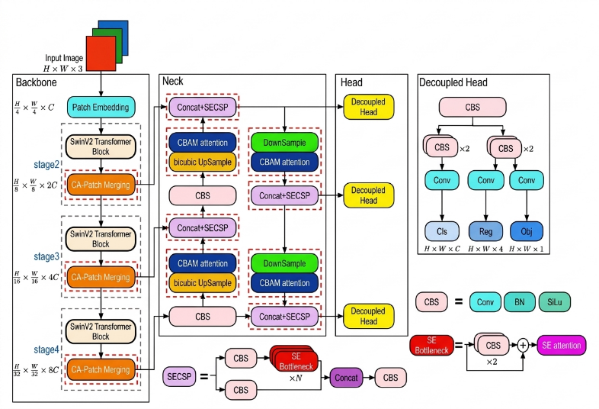
Module I — YOLOv12 Radiology Engine
Neural Network Architecture & Pathology Detection
Effusion
Opacity
Consolidation
Nodule
Cardiomegaly
93.8% accuracy
91.2% accuracy
89.5% accuracy
78.4% accuracy
96.2% accuracy

Slide 8
Module I — Training Protocol
The model was trained for 200 epochs using a weighted and annotated chest X-ray dataset to improve detection accuracy across different pulmonary pathologies.
Key Training Techniques
Cosine Learning Rate Schedule with Warm-up
Mixed-Precision (FP16) Training
Multi-Scale Augmentation
Used to stabilize training by gradually increasing the learning rate at the beginning, then decreasing it smoothly during training for better convergence and accuracy.
Implemented to maximize GPU utilization, reduce memory consumption, and accelerate the training process.
Applied to improve model robustness across different image resolutions and varying X-ray acquisition settings.
Data Augmentation Methods
These augmentation techniques helped simulate real-world radiographic conditions and improved the model’s generalization capability.
Random Horizontal Flipping
Mosaic Augmentation
Controlled Brightness and Contrast Variation
Random Horizontal Flipping

Slide 9
Module I — Clinical Significance of Output
The AI engine is designed to assist radiologists rather than replace them. It provides visual annotations, pathology labels, and confidence scores to support clinical decision-making. When a High Risk badge is displayed, the system has identified imaging features strongly associated with acute pulmonary pathology.
The confidence score acts as a Certainty Index, helping clinicians estimate the reliability of the AI prediction.
RED (High Risk) — Confidence > 85%
GREEN (Low/Clear Risk) — Confidence < 60% or no detection
AMBER (Moderate Risk) — Confidence 60–85%
Immediate clinical review is recommended.
Findings should be correlated with the patient’s clinical presentation.
Routine follow-up is generally sufficient.

Slide 10
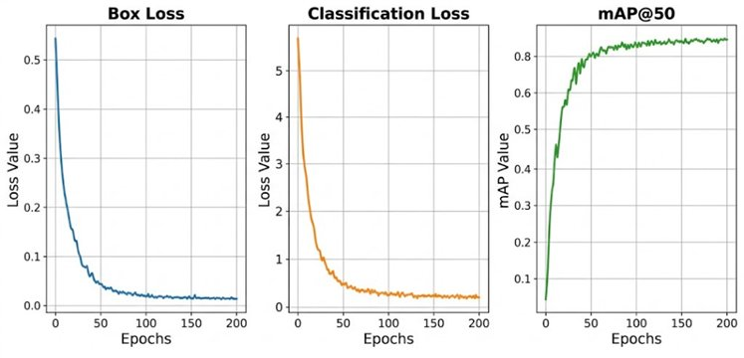
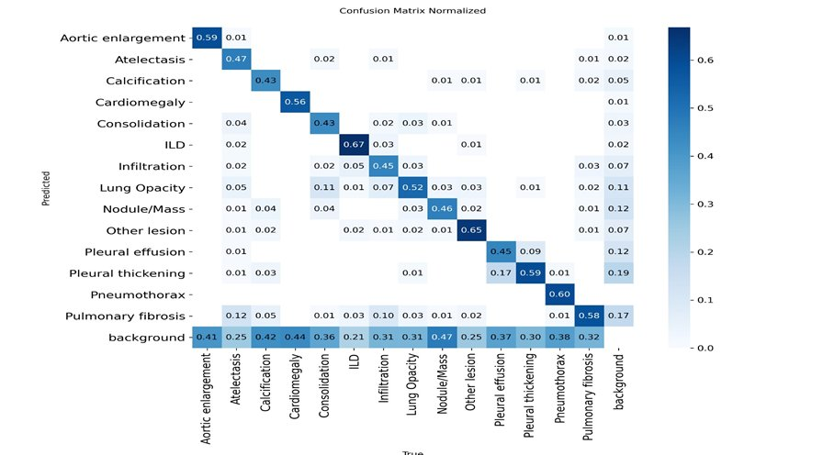
Module I — Training Convergence & Confusion Matrix
200-Epoch Training Protocol · Held-Out Validation Set
Metric
MedAI Result
SotA Benchmark
Status
Precision
94.1%
91.0%
EXCEEDS
Recall
70.3%
72.0%
Near Target
mAP@50
80.1%
78.0%
EXCEEDS
F1-Score
0.81
0.79
EXCEEDS

Slide 11
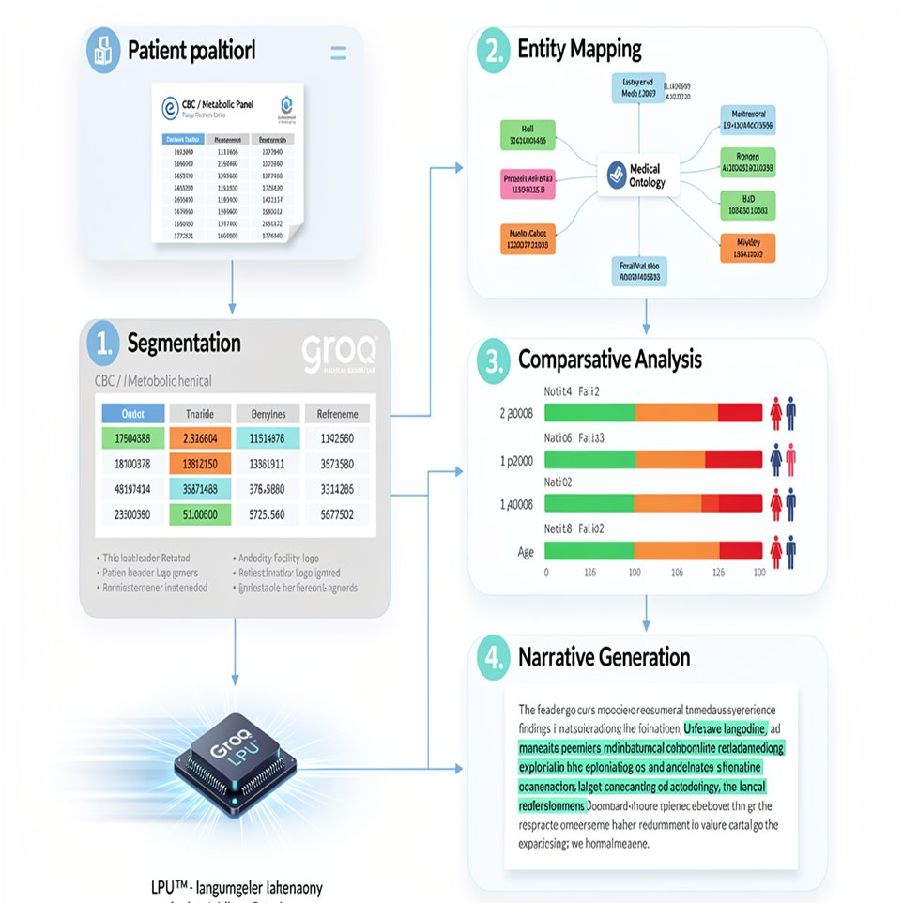
Module II — Multimodal Lab Interpreter
OCR + Groq NLP Pipeline
4-STEP PROCESSING PIPELINE
1
Segmentation
Isolates lab values from patient headers, logos & admin metadata.
2
Entity Mapping
Maps extracted values to standardized medical ontology across formats.
3
Comparative Analysis
Benchmarks each value against age/gender-specific reference ranges.
4
Narrative Generation
Groq 1M-context LLM explains clinical significance of abnormal findings.
CLINICAL MODE
Terminology-rich · ICD-coded · Differential diagnoses
PATIENT MODE
Plain language · Explains symptoms · Next steps

Slide 12
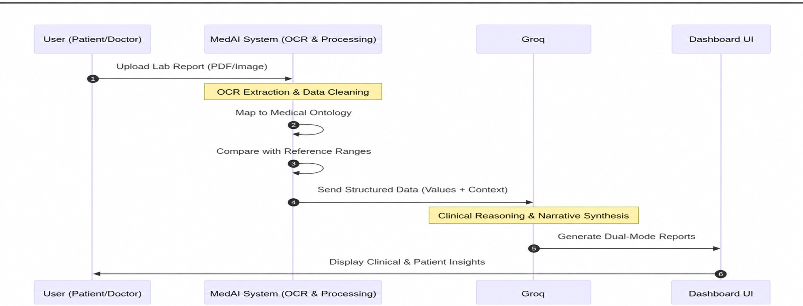
Module II — Lab Interpreter Sequence Diagram
End-to-End Operational Workflow

Slide 13
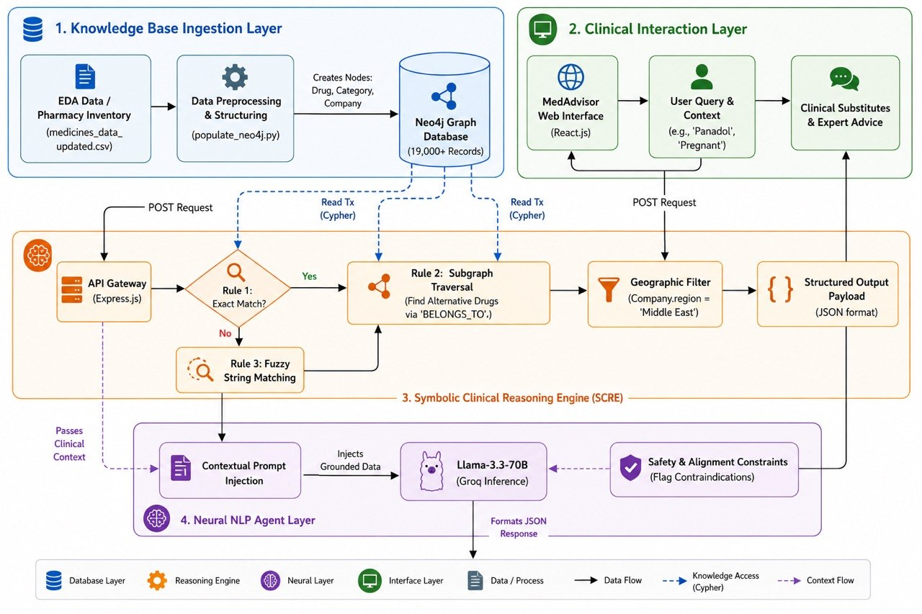
Module III — MedAdvisor Pharmaceutical DSS
Egypt-Localized Neuro-Symbolic Drug Substitution Engine

Slide 14
Module III — SCRE Engine
Symbolic Clinical Reasoning Engine · 19,000+ EDA Records
🗄 NEO4J KNOWLEDGE GRAPH
⚙ SCRE — 3 DETERMINISTIC RULES
Drug
Node
Category
Node
Exact Match Query
1
Query Neo4j: Drug → BELONGS_TO → Category + Drug → MANUFACTURED_BY → Company. Returns exact match with dosage & manufacturer.
Subgraph Traversal
2
Find alternative drugs via 'BELONGS_TO' edges. Geographic filter: Company.region = 'Middle East' ensures local availability.
Fuzzy String Matching
3
If no exact match: CONTAINS search for partial name matches. Reports 'Likely Shortage' and pivots to substitute retrieval.

Slide 15
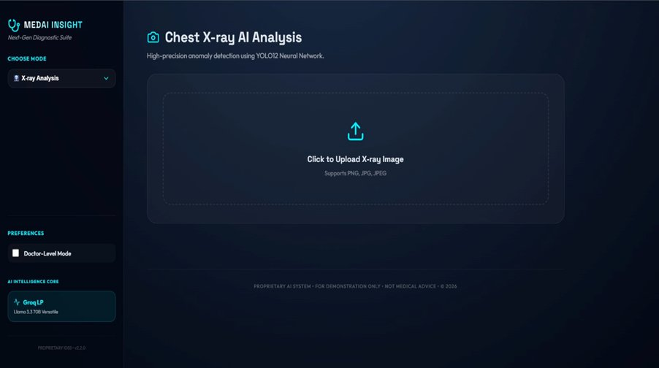
UI/UX — Clinical Dashboard & Ethics
Usability Under Pressure · Data Security · Ethical AI
UI/UX DESIGN PRINCIPLES
Reduced Cognitive Load
Single dashboard — no context switching between tools
Red/Amber/Green Cues
Traffic-light risk badges for immediate situational awareness
Real-Time Feedback
Progress indicators prevent premature interaction during inference
WCAG 2.1 AA
All elements meet accessibility contrast & size requirements

Slide 16
Future Development Roadmap
5 Phases · Q3 2026 — Q3 2027
Phase 1 · Q3 2026
Phase 3 · Q1 2027
Phase 5 · Q3 2027
DICOM
Support
Mobile Clinic
Clinical
Pilot
Direct medical-grade DICOM file processing
Low-bandwidth optimization for field deployment
Pilot study in partner hospitals
1
2
3
4
5
Phase 2 · Q4 2026
Phase 4 · Q2 2027
Predictive trend
Arabic
Interface
Historical lab analysis for longitudinal monitoring
Full MENA localization — Arabic UI

Slide 17

Thank You ☺

